Slide 1






EXPOSRE FUSION FRAMEWORK
IMRAN SHAIK 20BCE0009
SUBIKSHA JEGADISH 20BCE0439
RIDDHIKA J 20BCE0047
SOWMIYALAKSHMI G 20BCE2137

Slide 2


Current Method
2
1
3
Weight Matrix Estimation Enhance the low contrast of under-exposed regions while the contrast in well-exposed regions preserved[W = T**μ]
- computes the first derivative of the input image
-convolve with "Gaussian Kernal"
-computes the weights for the horizontal and vertical edges
Exposure Ratio Determination Extract the low illuminated pixels as
The mapping function between two images that only differ in exposure is called
Brightness Transform Function
(BTF).
power law transformation
The brightness component B is defined as the geometric mean of three channel:
Final Enhanced Image

Slide 3
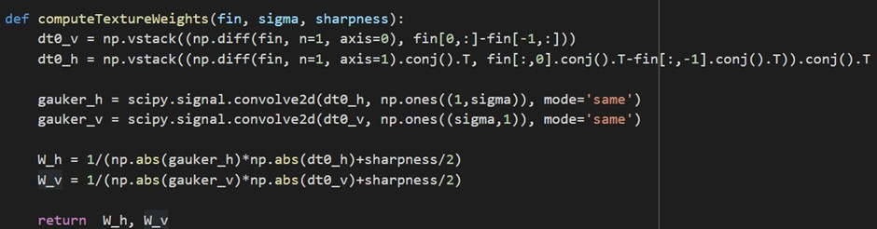
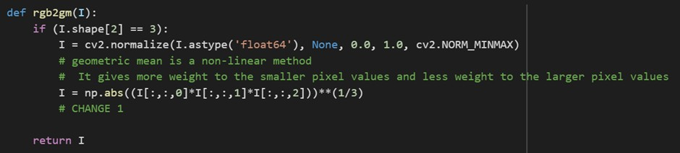
Compute Texture Weight Function - Gettting W
Brightness Component- Part of Estimation of k

Slide 4

Modification
old
Gradient along each direction and Gaussian Kernel
Sharpness parameter
Geometric mean of pixel values which are undex- exposed in the coputation of optimal k(Exposure ratio)
New
Applies Canny edge detection using OpenCV's Canny function
Adding up optimal Sharpness parameter.
Arithmetic mean of pixel values which are undex- exposed in the coputation of optimal k(Exposure ratio)

Slide 5
Modified Method
2
1
3
Weight Matrix Estimation Enhance the low contrast of under-exposed regions while the contrast in well-exposed regions preserved
- it applies Canny edge detection using Canny function with fixed threshold values between 100 and 200
Exposure Ratio Determination Extract the low illuminated pixels as
The mapping function between two images that only differ in exposure is called
Brightness Transform Function
(BTF).
power law transformation
The brightness component B is defined as the geometric mean of three channel:
B:= (Qr + Qg + Qb)/3
Final Enhanced Image

Slide 6
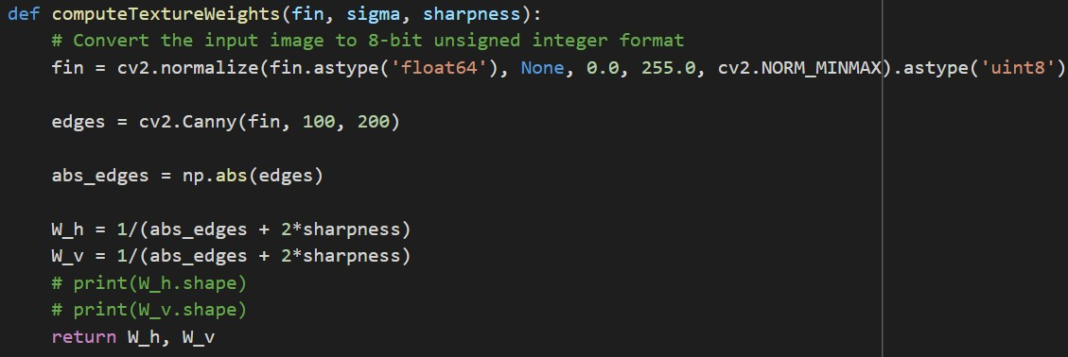
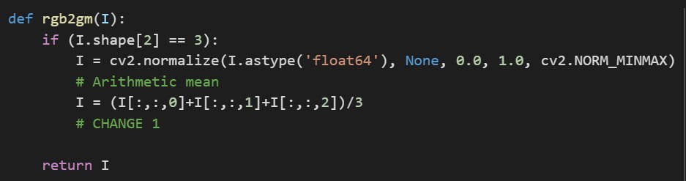
Compute Texture Weight Function - Gettting W
Brightness Component- Part of Estimation of k

Slide 7

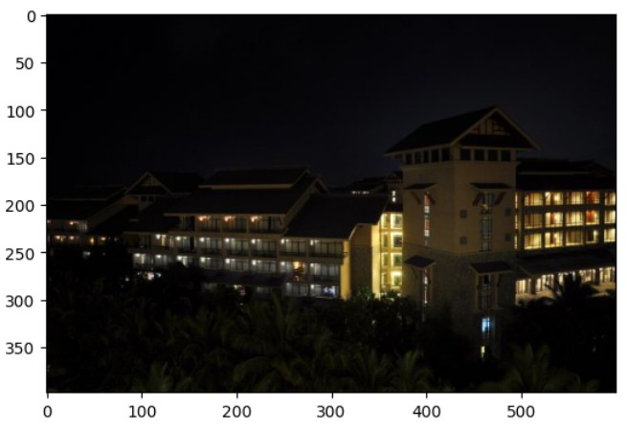
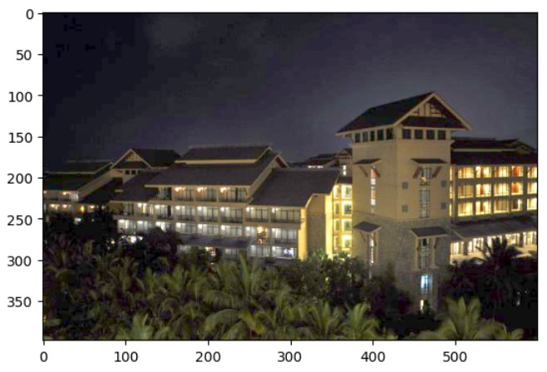


Output and Performance
Previous method based

Slide 8



Output and Performance
Modified method based

Slide 9
THANK YOU

